Slide 1
Time Series - Furniture Sales Forecast
Samraddhi Shrivastava​

Slide 2
Introduction
Time series analysis comprises methods for analyzing time series data to extract meaningful statistics and other characteristics of the data.
This dataset consists of daily sales data for various products at a superstore. We will need to apply Time Series to build a model to predict and forecast the sales of furniture for the next year i.e. predict future values based on previously observed values. We have a 4-year furniture sales data.

Slide 3
Agenda
Build a forecast model to predict the furniture sales of a certain store

Slide 4
Task to perform :::::
*Data Preparation
We remove unwanted columns that are not needed and check missing values. Aggregate sales data by date and finally index it with the time series data.
*Feature Engineering
We check the stationarity of the data and decide the next step to be taken. Also, decompose the data for further clarification and apply the time series model to the data.
*Model Comparison
We perform parameter selection to find the optimal set of parameters that yields the best performance for the model.
*Model selection task
We compare the predicted value to the real values and set the forecast from the start to the end of the data.

Slide 5
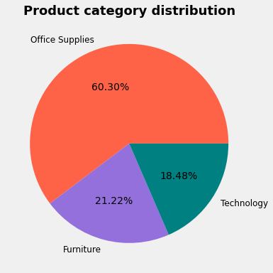
Product Category Distribution
Furniture | 2121
Interpretation::::¶
The products are divided into 3 categories of which the largest data is of office supplies category and the lowest is of technology.

Slide 6
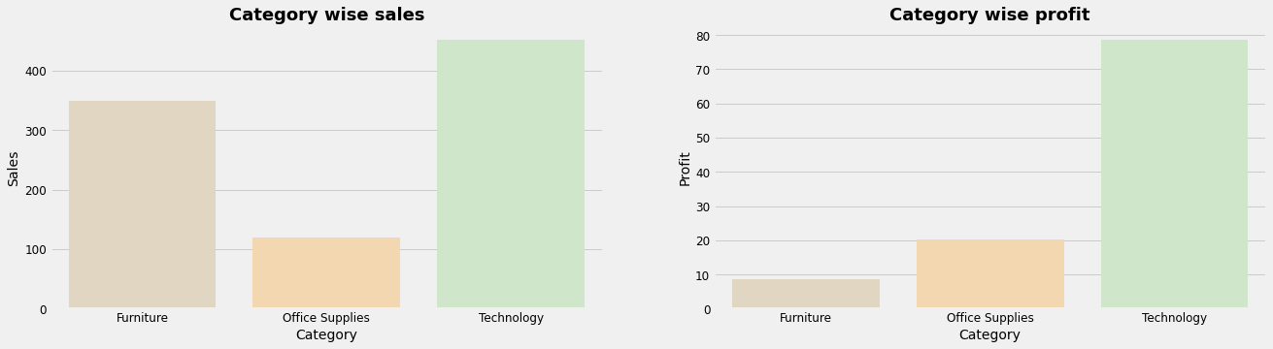
Dataset Analysis with EDA
Category Wise Sales and Category Wise profit
Interpretation::::
From here we can say that of the three category Technology is making more sales and profit, also we have high sales of furniture but profit is not high, which may be due to discount offers, also office supplies have been equal sales and profit.

Slide 7
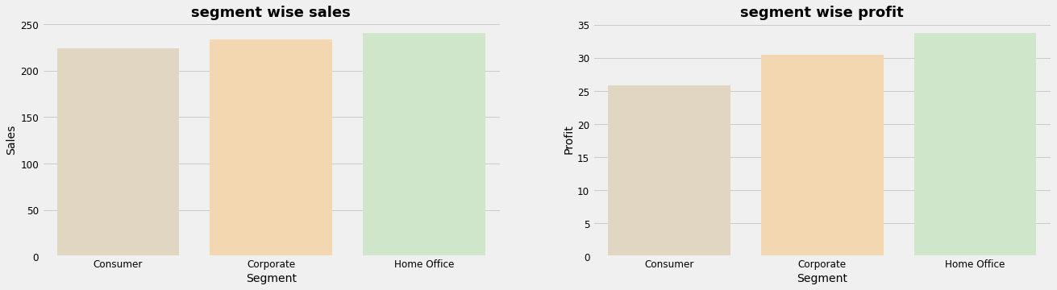
Segment Wise Sales and Segment Wise Profit
Interpretation :::
Sales and profit are higher in the Home-office segment and less in the consumer segment.

Slide 8
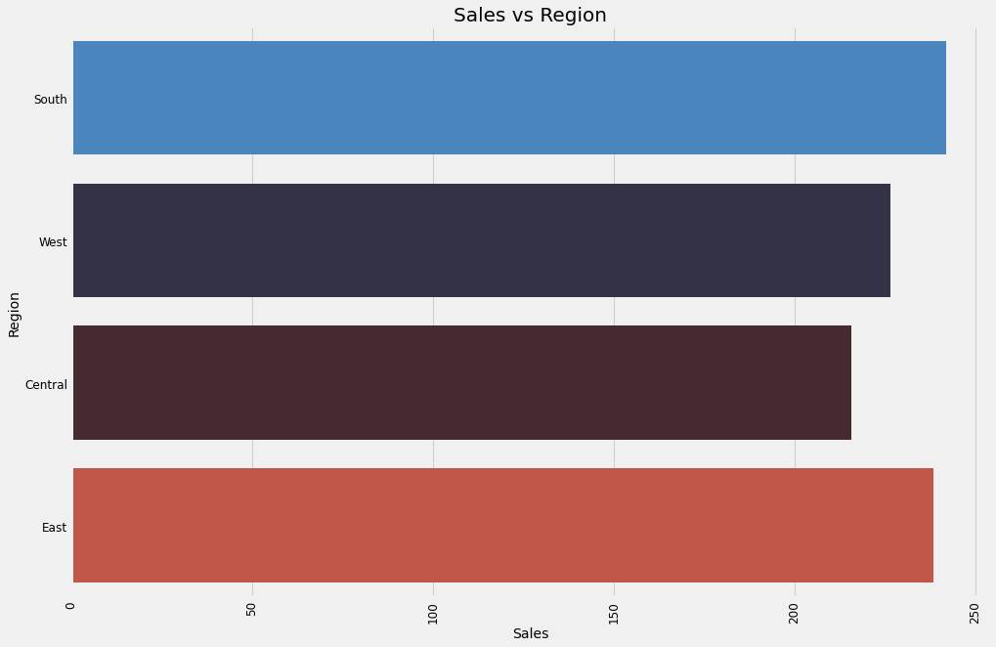
Region Wise Sales
Interpretation::::¶
Here we can see that we have the highest sales at south region

Slide 9
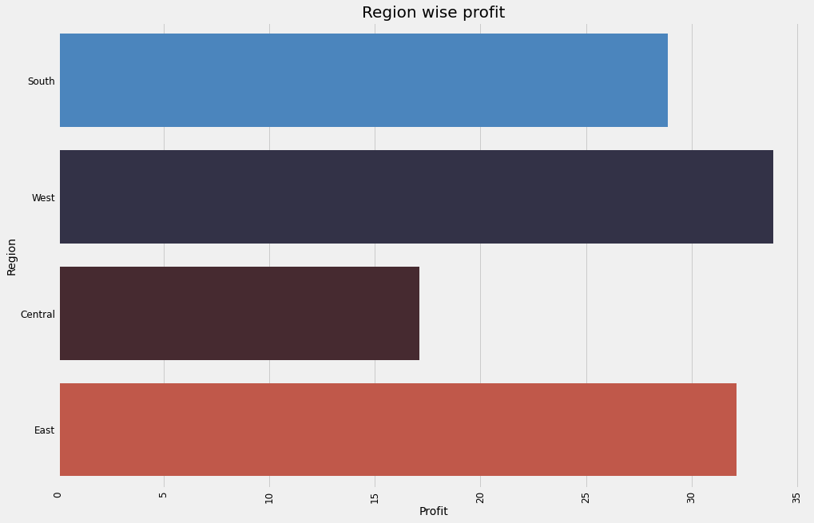
Region-wise profit
Interpretation ::::
After seeing both regions wise sales and profit we can say that we are getting the highest sales from the south and east region and the least were from central, but the profit we are getting highest from the west region also a good profit from east region.

Slide 10
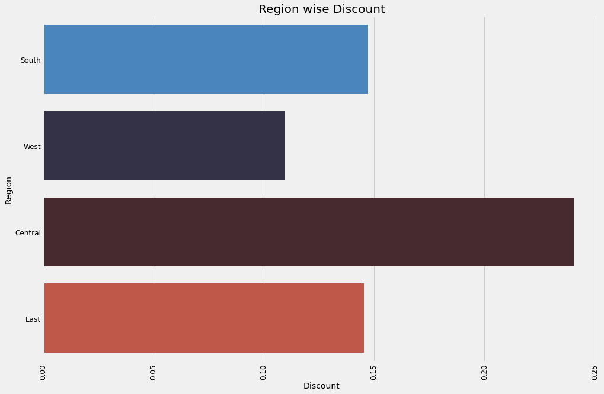
Region-wise discount
Interpretation ::::
we are giving the highest discount in the central region and the least in the west.

Slide 11
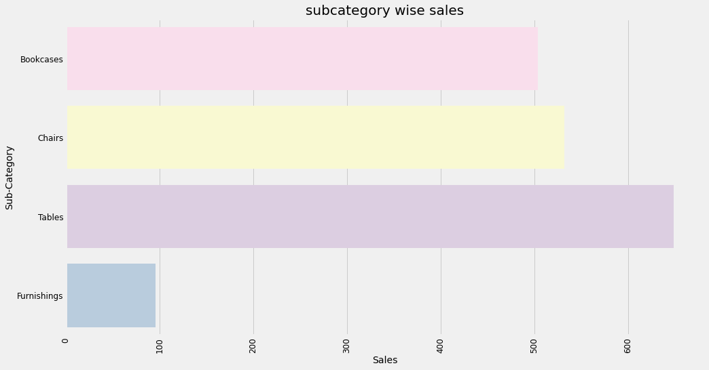
Sub - Category wise sales
Interpretation ::::¶
from the above graph, we can say that we are getting the highest sales from tables and the least is from furnishings, so we can maintain the range of this table and also can improve our sales from bookcases because ads we can see that is also putting good impact on sales.

Slide 12
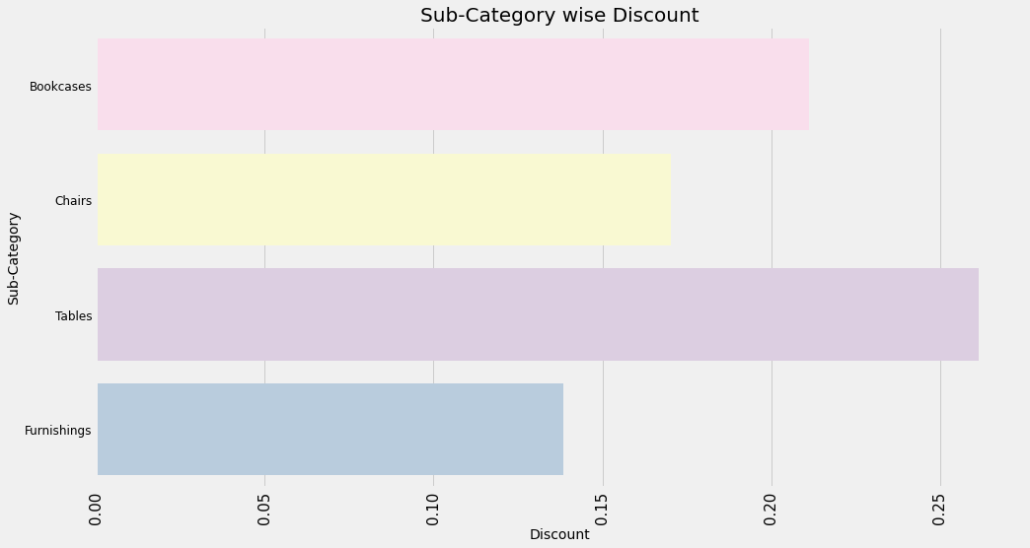
Sub-Category wise Discount
Interpretation ::::
from the above discount subcategory graph we can say that discount is highest in tables, and least in furnishings.

Slide 13
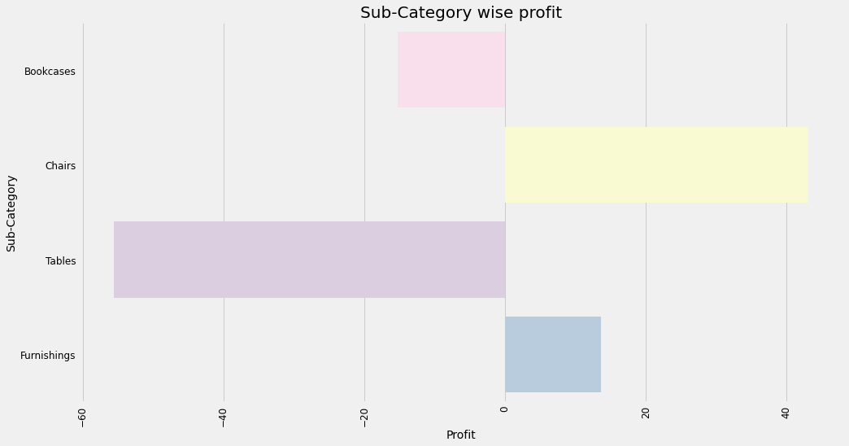
Sub-Category wise profit
Interpretation ::::
From the above graph we can see that as sales of tables are highest but we are not getting enough amount of profit from them and we are getting loos from that sales, chairs are holding the highest profit, and as sales of furnishing is less but sales and profit are parallel to each other.

Slide 14
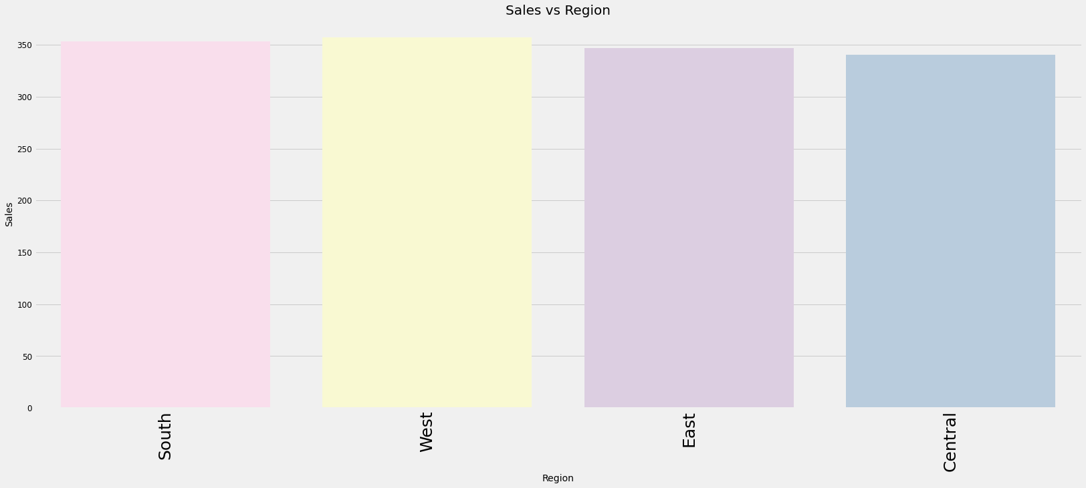
Furniture sales Region Wise
Interpretation ::::
furniture sales are almost equal in all regions, but a little more in the south region and least in the central region.

Slide 15
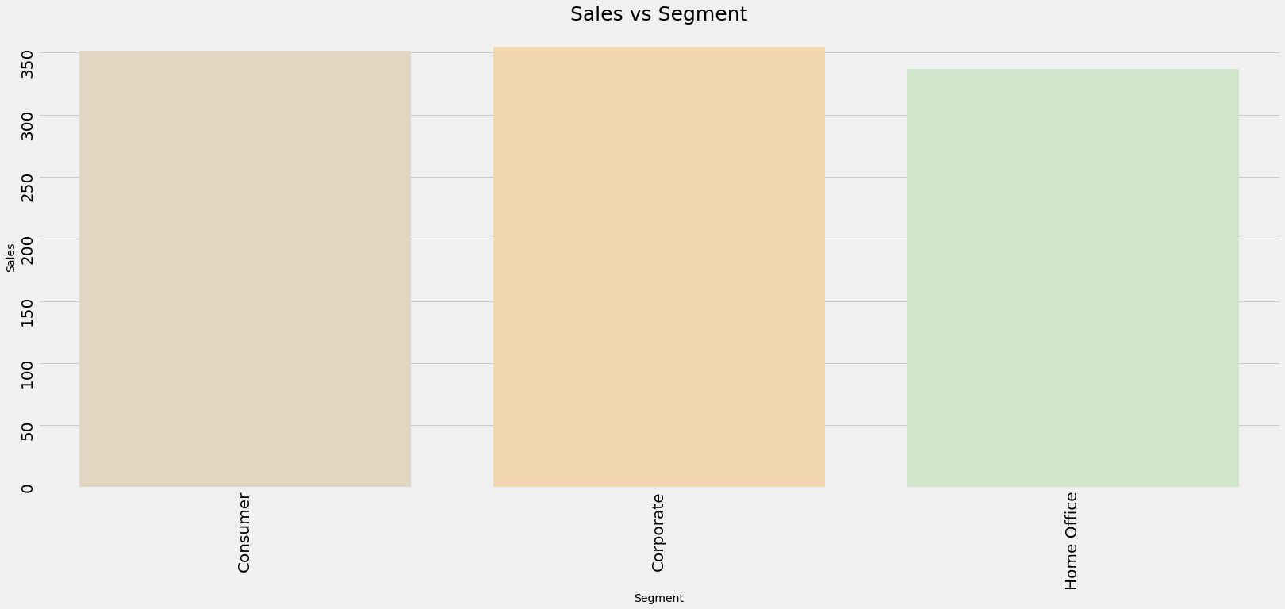
FURNITURE SALES VS SEGMENT
INTERPRETATION :::::
Furniture sales are almost the same in all segments.

Slide 16
Interpretation of the whole dataset ::::¶
1)The products are divided into 3 categories of which the largest data is from the office supplies category and the lowest is of technology.
2)Technology category has the highest number of sales and profits. Office supplies have less profit and sales and the furniture category has the least number of profit, also we can see that sales of profit are good but we are not getting profit acc to our sales, also we can say that in office supplies we have somewhere equally sales and profit.
3)Sales and profit are higher in the Home-office segment and less in the consumer segment.
4)After seeing both region-wise sales and profit we can say that we are getting the highest sales from the south and east region and the least was from central, but the profit we are getting the highest from the west region also a good profit from the east region
5)we are giving the highest discount in the central region and the least in the west.
Interpretation from furniture dataset:::::
After analyzing all the graphs we can conclude that we are getting the highest sales from the tables category but that’s because we are providing a high discount on that and because of that we are getting the highest loss from table sales, the second high discount is provided to the bookcase and hence we are getting second high to lose from the bookcase. best sales from our store are from chair range, where even by not giving too much of discount we are getting highest profit. As we are already getting good sales from tables and bookcases it means we are having some constant customers for these products Soo now we can decrease our discount rate on these products and can increase profit, also we can increase the little discount rate on chairs to get better more sales and profit as well form that.

Slide 17
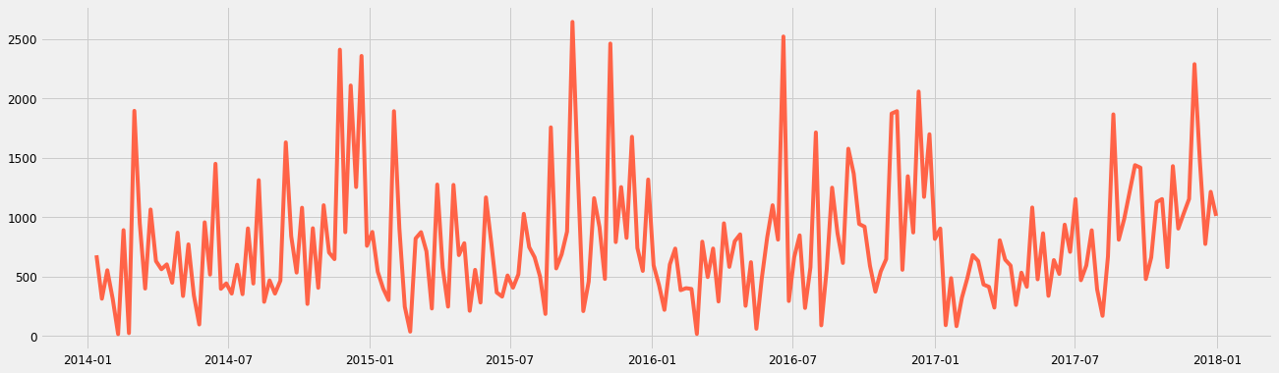
Visually checking the time series for trend and other components
Weekly data visualization
Weekly data visualization
Interpretation ::::
The visual show the weekly sales data from 2014 to 2018 The plot indicates that the time series has a seasonality pattern. The sales are always low at the beginning of the year and high at the end of the year. There is always an upward trend within any single year with a couple of low months in the mid of the year.

Slide 18
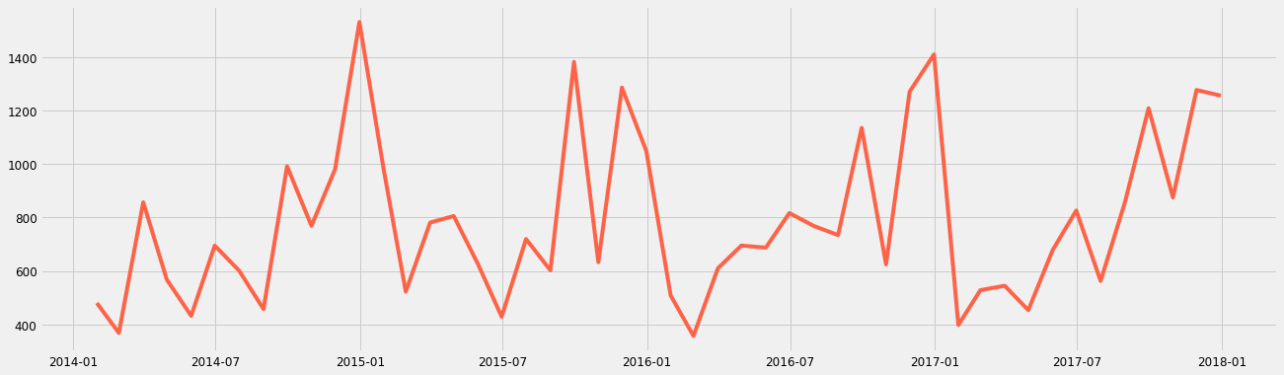
Monthly Data visualization
Monthly Data visualization

Slide 19
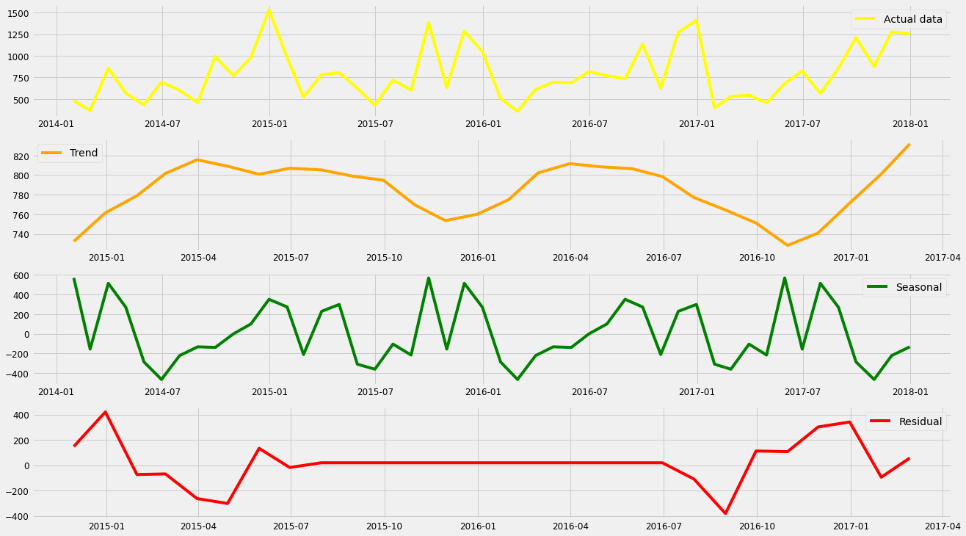
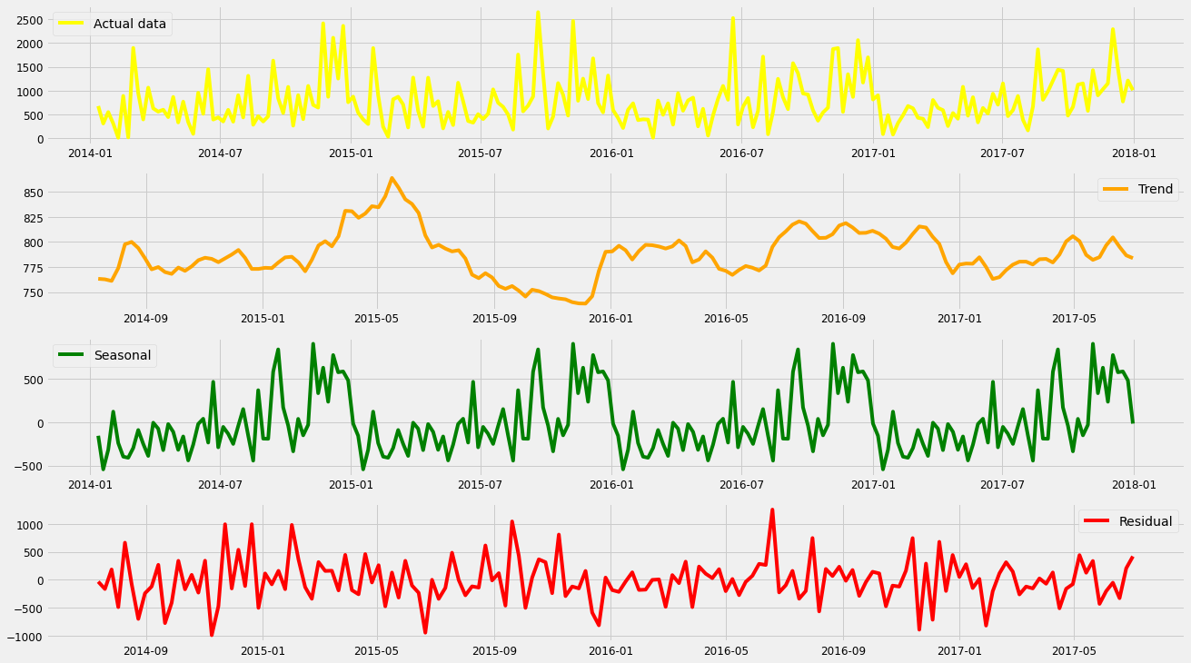
Monthly Data decompose
Decompose weekly data

Slide 20
Decompose of weekly data
Interpretation ::::
After seeing both data for monthly and weekly I will go further with modeling work with weekly data because with that I will get more data points to predict. By visualizing the decomposition components of the original time series we can say that the sales of furniture are unstable along with its obvious seasonality is also present in the dataset.
But we can not give any conclusion on stationarity, Soo will go for the dickey-fuller test.

Slide 21
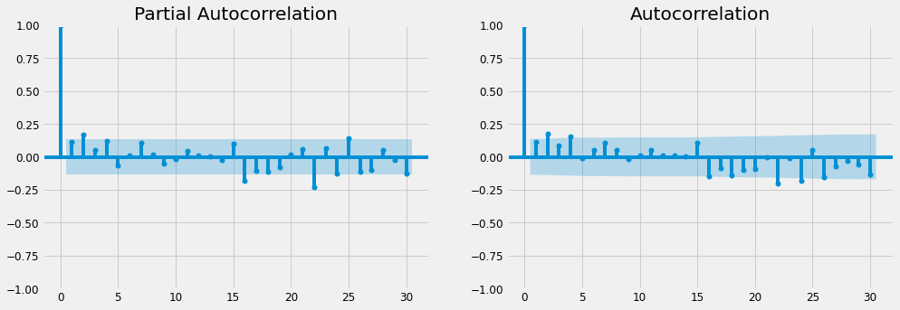
ACF and PACF plot for weekly data
interpretation ::::
above is the ACF and PACF plot of weekly and monthly data, because I will consider weekly data soo I will take p =3, q = 4.

Slide 22
Selection of model to predict
MODEL NAME | MSE | RMSE | AIC | BIC
Arima model | 248323.586590 | 498.320767 | 2238.667619 | 2262.481489
sarima model | 224118.808511 | 473.411880 | 2248.322269 | 2278.089606
Sarimax model | 203720.624757 | 451.354212 | 2262.503952 | 2289.294556

Slide 23
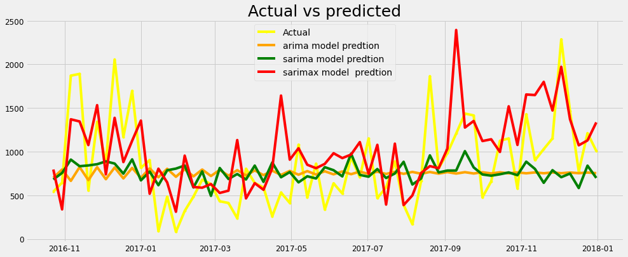
Plot of Models
Interpretation::::
After the visualization and error values of all the models, my interpretation is Sarimax model is giving me fewer errors also visualization of the Sarimax model is better, so I will keep this model for future sales procrastination of furniture sales.

Slide 24
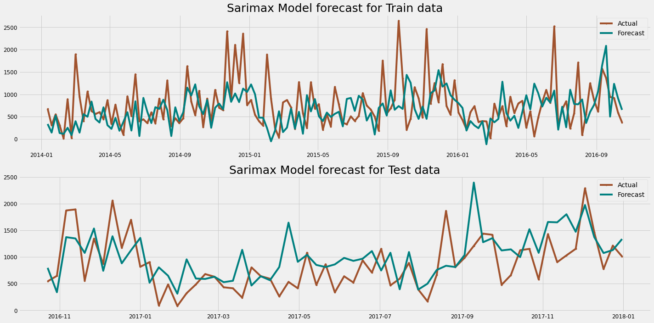
Forecasting with SARIMAX

Slide 25

Thank you

